Slide 1
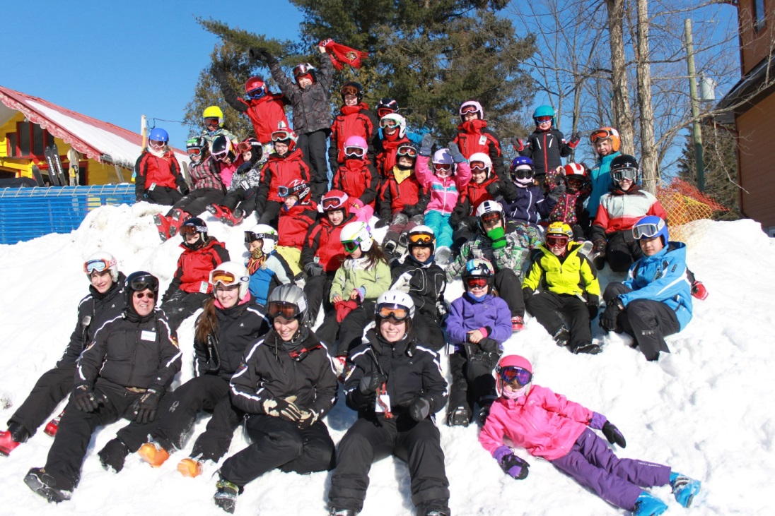
Edelweiss Racing Team
Nancy Greene Program Information Session
February/March 2016
Notes:
Note that MSSI is not a non-profit organization but that the club uses them to employ, pay and insure the coaching staff.
Our combined fees to the ski school and club are highly competitive within our region.

Slide 2
Intro - Edelweiss Ski Racing Team
Competitive Program – U10, U12, U14, U16, U18
Starts in September with Dryland Training, then on snow by end of November.
Minimum two days per week (Saturday and Sunday).
Optional weekday training.
Focus on perfecting ski technique and improving performance.
Five or more OSZ races with individual race results.
Nancy Greene Program
Typically one day per week (Saturday or Sunday).
Recreational approach to training.
Four Sunday OSZ races with team results.
One in-house race with All-Terrain and U10.
Notes:
Like the NG program is the next logical progression from the Edelweiss ski school, the Competitive Program can be a next step for athletes who which to move to the next level.
Christmas Camp – An excellent opportunity to scrape the rust off of your young athlete’s skills before the start of the regular season.
We routinely see remarkable progress during the four consecutive days of training.

Slide 3
Nancy Greene (NG)
Recreational approach
Fun comes first, but serious training close second!
Create an environment where athletes that WANT to come train - athletes develop best when they are motivated
Learning goals
Develop fundamental skiing skills and self-confidence in a ski race environment – while having fun.
Spirit of competition
Emphasis is on participation.
Team effort – everyone contributes to team results.
Notes:
Important to emphasize that the goal is to develop the basic or fundamental skiing skills in a race environment but that a chief goal is to ensure that they enjoy skiing.
In this environment, you should see your young athlete’s skiing skills and self confidence will develop quickly

Slide 4
NG Schedule – 2017 (Tentative)
12 week program:
Christmas camp Dec 27-30 (included in program cost).
First weekend is Sat Jan 7 / Sun Jan 8.
Last weekend to Sat Mar 18 / Sun Mar 19.
Total days on snow:
Saturdays: 25 (20 training days + 5 races)
Sundays: 20 (15 training days + 5 races)
Training hours:
9:30-11:30, 12:30-14:30

Slide 5
Nancy Greene Race Locations
Edelweiss
One OSZ race
One in-house race with All-Terrain and U10.
Vorlage
Two races: typically first of season and last of season (Julie Thompson Memorial).
Mont Sainte Marie
All races are Giant Slalom (GS).

Slide 6
Nancy Greene Coaching
Ski school program groups, including All-Terrain, are led primarily by CSIA-certified instructors.
Focus is on teaching to ski.
Quality of instruction is very good, but style is a bit different from Nancy Greene.
Nancy Greene Program groups are led by CSCF-trained/certified coaches.
More emphasis on ski performance, training, and athlete education.
Some coaches will also be CSIA certified.
Training sessions follow a structured plan prepared by the Nancy Greene lead coach/coordinator.

Slide 7
Nancy Greene Evaluations
Evaluations conducted based on Snow Stars program:
CSCF standardized evaluation program.
Seven levels, with Gold/Silver/Bronze assessment for each requirement of a level.
Most Nancy Greene athletes will be Level 2.
Younger athletes typically end up at high end of Level 1.
Some older athletes may evaluate as low end Level 3.
http://www.snowstars.ca – check out the material for parents.
Evaluations will be reviewed with the athletes twice per season.

Slide 8
NG Ski and Race Equipment
Clothing: Regular skiwear, no skin suits.
Skis: Junior race ski or SL shape recreational/All-Mountain ski recommended – no twin tips.
GS skis not required.
Bindings pr0fessionally adjusted.
At a minimum, tuned once at the beginning of the season.
Poles: Mandatory, with baskets.
Helmet: Hard ear helmet is mandatory.
Coaches will discuss with parents if they observe potential safety issues with your child’s equipment
e.g. Missing parts, cracked helmets and goggle lenses, end of life equipment, poor fitting bindings, etc.

Slide 9
Parent Involvement
Race officials for Edelweiss hosted races:
30-35 officials are required per race (registration, course crew, gate judges, course slippers, etc).
All families should complete Level 1 training.
All families encouraged to complete Level 2 training.
Each family is requested to contribute as a race official at least 4 times per season.
Nancy Greene level representative (one):
Circulates race notice to all NG parents.
Informs race secretary of Edelweiss scratches.
Provides pictures of athletes for yearbook.
Provides feed-back at end of season.

Slide 10
Edelweiss Race Room
Ideal for dressing, lunch, and post training.
Good place to socialize with other families.
Located close to coaches room, facilitating coach interactions.
Coaches often interact with athletes at lunch, either socially or to discuss progress/plans.
Training video review sessions conducted in back room (1-2 times per season).
Reserved seating for our home team when we host races.

Slide 11
Edelweiss – Team Benefits
Equipment and clothing discounts:
Kunstadt – 15% discount (2016)
Sporting Life – Blue card for 10-20% discount (2016)
Social events:
Tubing and potlucks.
Ski tune-up clinics for parents.
Bake sale during U10 or U12 championship weekend.
Year-end OSZ banquet and awards.
Year-end Edelweiss Racing Team banquet.

Slide 13
Early Bird Registration
Applies to race program registration.
Before April ~15 – best discount available.
Before mid-October (usually Thanksgiving weekend) – ~10% discount to regular rate.

Slide 14
QUESTIONS???

