Slide 1
Parents’ meeting (U) Réunion des parents (U) October/octobre 2017
Welcome!
Bienvenue!

Slide 2
Meeting Agenda
Executive team, org chart, volunteers
Club News
Coaching
Race Coordination
Branding
Events outside regular OSZ calendar
2017 Season Feedback
Awards
Fundraising
2017 Financials / 2018 Budget
OSZ Updates, Equipment, Resources

Slide 3
Org chart
President Andy Benson
Treasurer Chantal Martel
Registrar Janik St-Jean
Vice-President Eric Belliveau
Age Group Reps (NG – U16)
Sponsorship
Team Jacket coordinator TBD
Head Coach
Mario Gagnon
Equipment
Manager Matt Wheatley
Officials Coordinator Isabelle Roy
Timing
Manager Denis Cabasson
Race Coordinator Cédric Perron
Branding Sheldon Shaw
Secretary Suzane Tremblay
Past President Nathalie Lepage
Emergency Cards Pascale Bazinet
Athletes of the month Jacinthe Arsenault
Event Coordinator Karen Benson
Social Convener TBD
Edelweiss Banquet TBD
Wreath Coordinator Kelly Campbell
Webmaster Gerrard Leach
Le Défi Alpin (Le Ralais) Coordinator TBD
Year-end Survey Coordinator
TBD
Notes:
Request volunteers for Year-end coordinator (surveys), Social Convener, Edelweiss Banquet and Le Ralais Coordinators; Open positions for next year’s Executive will be advertised at the Edelweiss Banquet at the end of the year (President, Event Coordinator)

Slide 4
Age Group Reps
Nancy Greene: Katie O’Brien
U10: Sheldon Shaw U12: Michel Pariseau
U14: Isabelle Roy U16: Kelly Campbell
Inform race secretary if Edelweiss had any scratches for their upcoming race
Prepare “what happened last week” – posting on Facebook or blog on website
Speed camp (U14, U16). Organize the lodging and meal planning for the speed camp. Register the Edelweiss athletes. Confirm the parents who will stay overnight at the cottage. Follow-up on payment for each participant.
Tentative Dates:
U14 – February 21-24 (Calabogie; Optional second day of races Feb. 25)
U16 – February 7-11 (MSM)

Slide 5
Feedback from 2017 Season
Success…53 responses
coaching
Sharing of skiing expertise
Kundstadt, Side Cut tuning, tuning machine
Pre-season Dry-land and Trip
Athlete Success
Club spirit.
Areas for improvement
Communications
Optional training vs program
Officials training
More Social events at Edel, incl of NG.
The Race Room
Notes:
Eric to update, as needed, and elaborate on feedback received and what we’re doing about it.

Slide 6
Club News
New Start hut for Edelweiss, built by Algonquin College students (coordinated by Matt Wheatley); Inauguration of new Strief Timing Hut; New timing wiring
Working on SL homologation for Strief
Preliminary schedule has 5 events at Edelweiss:
U16 SL Championships (Strief)
U14 SL (Strief)
U12 GS
U10 Skills
NG
Preliminary Athlete Numbers (131+):
U16: 17 U14: 21 U12: 25
U10: 19 NG: 49

Slide 7
Coaching
Head Coach – Mario Gagnon
U16 – Nico, Mathieu
U14 – Dave, Patrick, Chris
U12 – Martin C., Maddie, Ray
U10 – Fed, Martin P., Morgane
NG – New Coaching Coordinator: Emily
Notes:
Confirm with Mario

Slide 8
Season Long Goals
Early season: More ability-based groups
More goal-based courses
Focus on more movement
Focus on confidence building

Slide 9
Season Schedule
Start: December 16th
Christmas Camp: Dec 27-30th
Optional: Tuesday Evening, Fridays

Slide 10
Officials/ Officiels
Formation des officiels / Training for officials (see Isabelle Roy)
Niveau/Level I: 06 and 07 Jan 2018, may add more 13/14 Jan
A.M. English
P.M. Français
Niveau/Level II: November 4, 2017, 9 am – 4 pm, Edelweiss
All Hands Meeting – November 23??, 2017, Tom Brown Arena (Mandatory for Level II+ at least every two years)
Parents qualifies: 66/122
Niveau 1- 43
Niveau 2 – 20 (moins de 25%)
Niveau 3 - 3
Shadow Positions
Notes:
Need to confirm dates

Slide 11
Parent involvement / Bénévolat
Race official and volunteering:
All families should complete level 1 training
All families are encouraged to complete level 2
All families should contribute to:
U level - 4 racing activities
NG Level – 2 racing activities
All level - one “Pot Luck” contribution, race day
Statistiques 2017
Niveau U - Approx 80% des familles ont fait 4 + jours
Niveau NG- Approx 70% des familles ont fait 2 + jours
Sign up = show up please!
Notes:
122 parents
- 54 NG 54 X 2 = 108
- 68 U 68 X 4 = 272
total = 380
Requis 60 par course 60 X 5 = 300

Slide 12
Parent involvement / Bénévolat (2)
Préparation - jeudi soir / samedi matin
Race day “Pot Luck”
Volontaires pour les autres clubs
U10 Skills ??
Championnats - mi mars

Slide 13
Volunteering Register / Inscription pour le bénévolat
New Tool – SignUpGenius
Courriel initial vers le 15 décembre
Don’t have to sign in, but………
Rappel 2 jours avant l’évènement
List for chief race/ chief of course etc……
Changement – e-mail

Slide 14
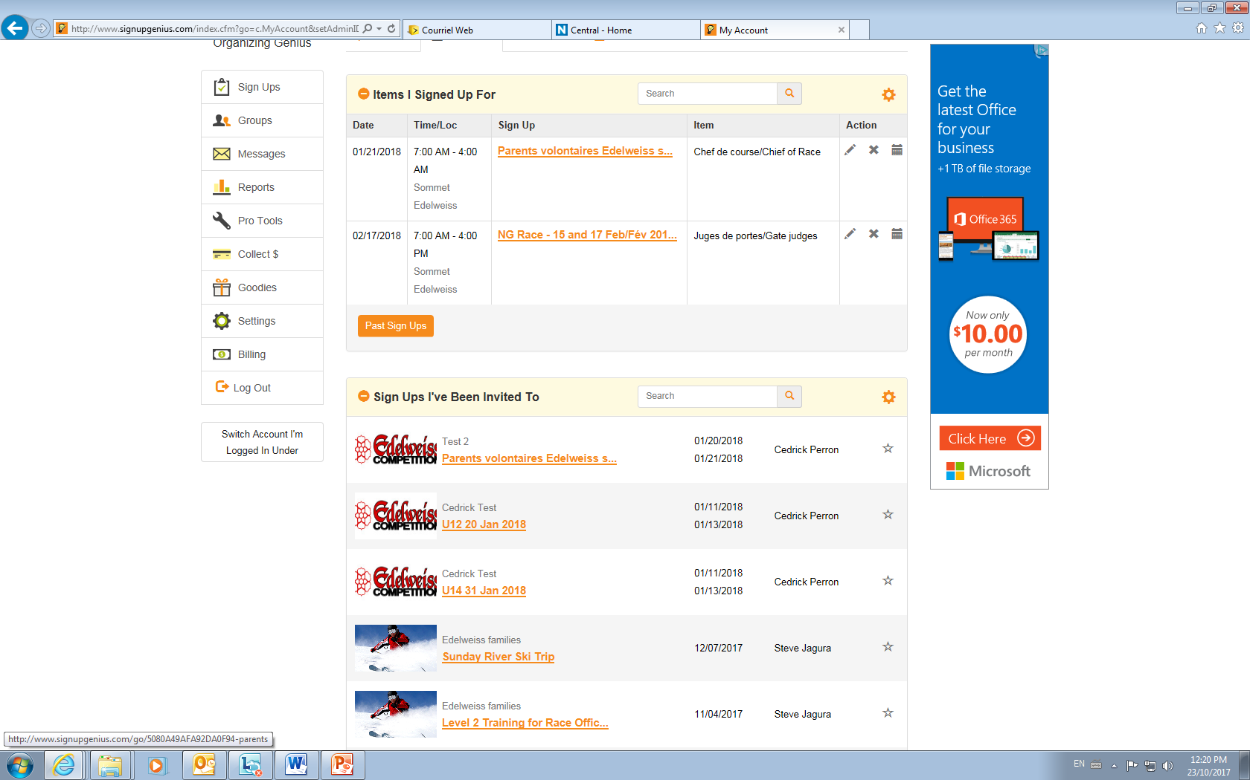

Slide 15
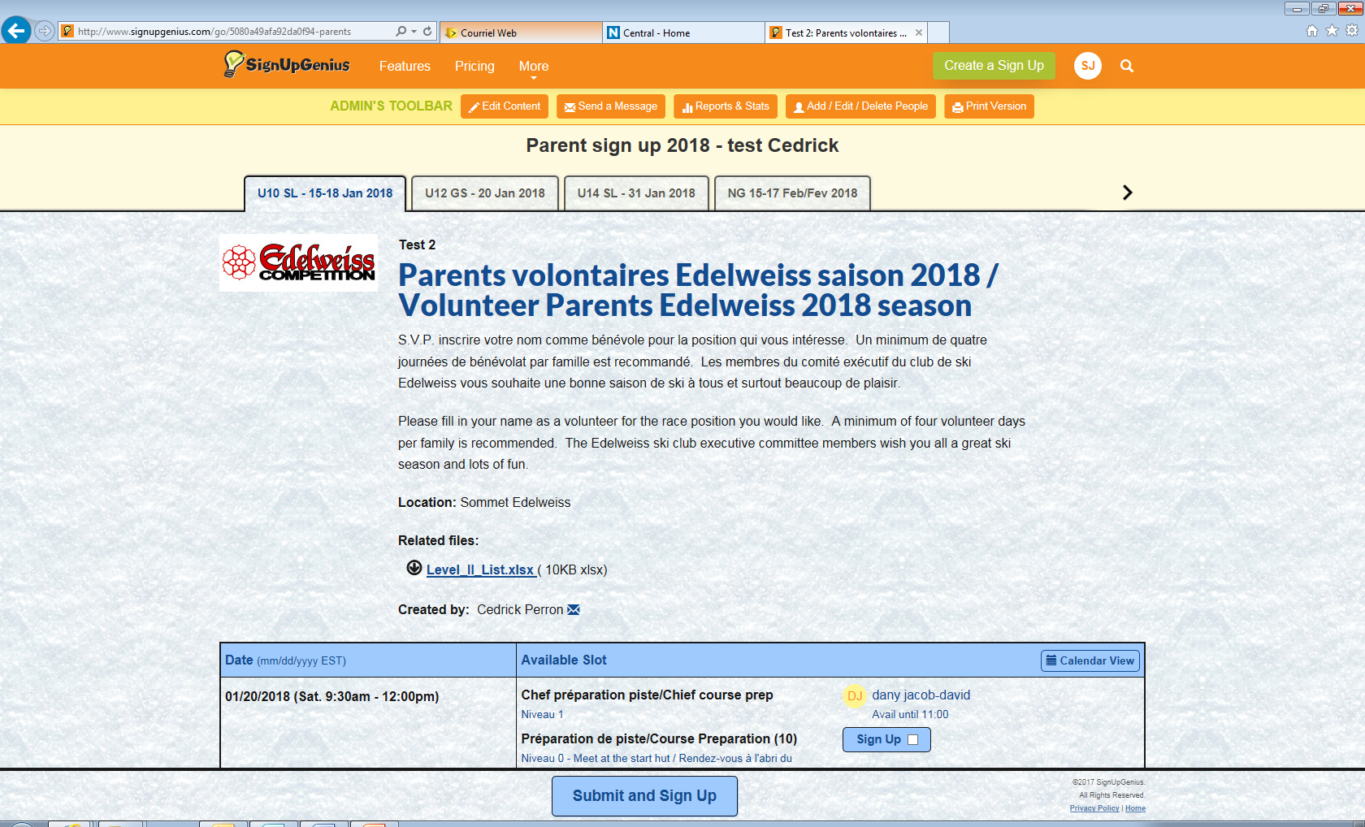

Slide 16
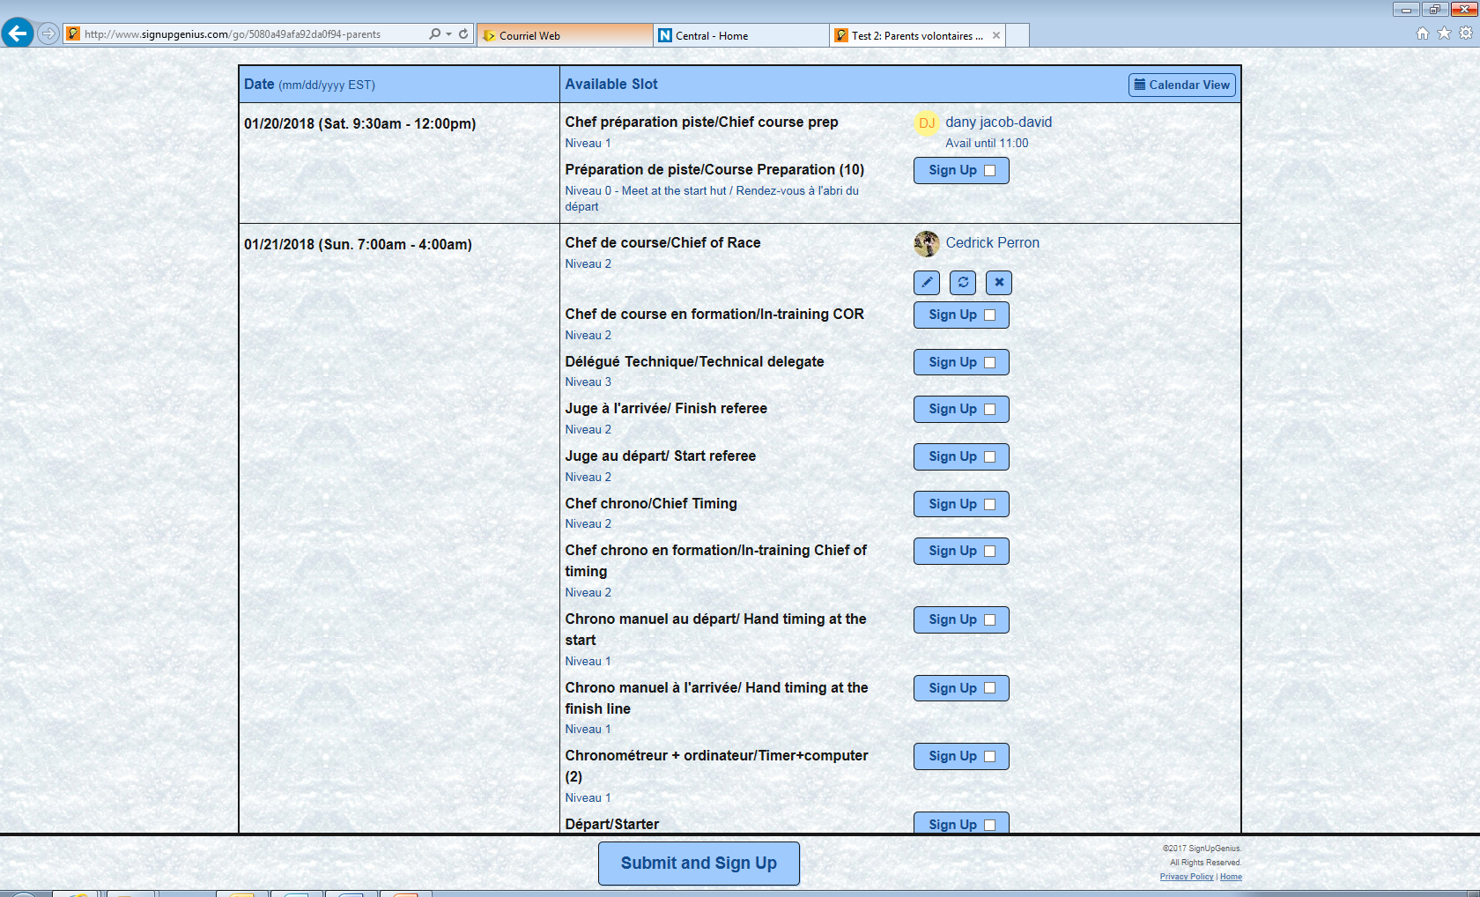

Slide 17
Inscription pour le bénévolat Volunteering Registration
Inscription avant le 07 Janv 2018!
Register before 07 Jan 2018!
Merci de votre contribution !
Thank you !

Slide 18
Branding
Communications
Website – Gerrard Leach
Branded Items:
Ski Jackets (Karbon) – delivery end of November
Cow bells
Ski Boot Bag Badges
Dryland shirt
Ski straps
Winter shirt order – accepting feedback for shirt type to order
Under consideration:
Hats/touques, Travel Mugs, other items
Notes:
All branding items are considered to be cost neutral – meaning all costs are passed to the purchaser. Important year as we need to evaluate and decide on the clothing contract for the next 3 years. Non Scientific feedback has been positive in terms of Karbon – both in terms of cost and durability. Lots of opinions on color and color scheme for the club due to changes in the MSSI logo and the addition of the Kundstadt logo

Slide 19
Events outside OSZ calendar
Pre-season ski training (Sunday River) | U levels
Early season ski training (Saint-Sauveur) | U levels
Défi carnaval at Le Relais | NG – U12
Speed camp | U14 and U16
Camp Relève | 2nd year U14- need to qualify
End of season provincials | U12, U14 and U16 – need to qualify
CAN-AM finals | U 14 and U16 – need to qualify

Slide 20
Example of expenses for outside events
Expenses | Sunday River Pre-Season Trip | Pre-Season Sommet Sauveur Trips | Speed camps | Defi carnaval LE RELAIS
Accommodation | See Next Slide | N/A | Approx. $100 (arranged by the club) for 4-5 days | $125-150 per night
Meals | $30- 50 per day | Pay your own | $20-30 per day | $30-50 per day
Coaching fees (accommodation, other expenses incl.) | $165 for 3 training days | MSSI planning 4-pack extra training packages (also for use Tuesday nights @ 0.5 per and Fridays) | Paid hours 14:30-16:00 (only if applicable) | $50 per training day (paid to club)
Lift tickets- Registration | See Next Slide | Edelweiss passes good at MSSI in pre-season | $0 (included in race fees) | $95 (fees for 2017)
Notes:
To be updated by Karen

Slide 21
Pre- and Early Season Trip Pricing
Sunday River, Maine, December 7-10 (Friday to Sunday; travel Thursday)
Passports and border consent forms (if bringing someone else’s child or travelling without second parent) required; Travel insurance recommended
Studio Hotel room in Grand Summit Resort Hotel (hillside): $129/night USD
Queen murphy bed plus Queen pull-out; full kitchen in each room
Health club with outdoor heated pool and two hot tubs
Games room, coin laundry, free WiFi, DVD and X-Box games
3 day lift passes for 2 adults and 2 youths (7-18 years old): $486 USD
See September 19 email for other pricing options
Coaching costs: $165 for 3 days (same as last year)
All prices in USD except coaching cost, including tax
Last year 32 athletes attended, this year 48 athletes
Notes:
To be updated by Karen

Slide 22
Défi Carnaval Le Relais
SQA will announce quota per club
Only one person (?) will be able to do initial booking this year (acceptance of quota) and request for additional spots
Last year initial quota was 8 but we eventually got all spots requested (15)
Respond to the club if interested
Priority protocol:
2nd Year U12 athletes (last year of eligibility)
Siblings of attending 2nd Year U12 athletes
Athletes who have never gone
U athletes
NG athletes
Notes:
Karen to update

Slide 23
Dates: Check Edelweiss calendar
Race fee registration + emergency ID: Sat Oct 28
Level II race official: Nov 4
Last day of Dry Land & Nutritionist Seminar: Nov 11
Optional Pre-Season Training at MSS: Nov 18, 25, Dec 2
Optional Pre-Season Trip to Sunday River: Dec 7-10
First day of ski season: Saturday Dec 16 (U-Program)
Christmas camp (NG and U): Dec 27-30
Sport psychology sessions: TBD
Edelweiss banquet: TBD

Slide 24
Awards
4 themes
Mid Jan
Mid Feb
Mid March
Year End banquet
Most improved Y0Y U10, U12’ U14’ U16
Most outstanding U10, U12, U14, U16
Ted Puttick
Volunteer of the Year!
Notes:
Eric???

Slide 25
Fundraising….sponsored by
Sponsor letter is available on teamedelweissequipe.com
Gate Panel sponsorthip sought, 1 leading candidate
Holiday wreaths: we strongly encourage 5 wreaths per family
Most profitable fundraiser is a race.
 | Amount | Visibility
Double Black Diamond | $5500 for 3 yrs | Logo on racer jackets & web-site Logo on Zoomer finish hut & Start Hut during races.
Black Diamond | $3500- 3 yrs. | Logo on racer jackets & web-site Logo on Streif Finish Hut & potential Start Hut during races or Logo on gate panels.
Blue | 2500$- 3 yrs. | Logo on racer jackets & web-site
Green | 500$ | Logo on team web site
Notes:
Eric to update

Slide 26
Edelweiss = Benefits
Kunstadt - Race Team 15% Discount
Regular prices Skis, Equipment, Clothing
Kunstadt points
Sporting Life – Blue Cards
Racer Nights - savings (Fall) at Kunstadt and Sporting Life stores- check your emails and/or website
Notes:
Eric to update

Slide 27
Net Revenue
 | 2017 Budget |  | 2017 Actual |  | 2018 Budget
Revenues net of Variable Costs
Gross Registration | $56,411.00 |  | $56,916.00 |  | $67,523.00
Net Registration | $5,105.50 |  | $9,827.50 |  | $4,417.00
Gross Home Races | $10,758.00 |  | $9,863.00 |  | $6,947.08
Net Home Races | $7,923.00 |  | $6,141.80 |  | $4,586.28
Dry-Land | $3,106.00 |  | $2,756.78 |  | $387.00
Fundrasing and Sponsorship | $2,352.00 |  | $2,460.00 |  | $5,500.00
Net Revenues | $18,486.50 |  | $21,186.08 |  | $14,890.28
Current Cash Balance | $17,278.00 |  | $17,278.00 |  | $15,250.00
Float | $(10,000.00) |  | $(10,000.00) |  | $(5,000.00)
Available for Capital Expenditures & Fixed Expenses | $25,764.50 |  | $28,464.08 |  | $25,140.28

Slide 28
Fixed Expenses
Expenses | 2017 Budget |  | 2017 Actual |  | 2018 Budget
Racing Infrastructure
Timing S/W | $300 |  | $441
Radios (mircophones) | $3,000 |  | $250 |  | $2,850
Misc (Team Snap ,Laptop, Scraper Sharpener, Website, etc.) | $2,000 |  | $2,848
B-nets, gates, bits, pieces etc. | $2,000 |  | $5,258 |  | $3,810
Timing wire | $3,000 |  | $1,100 |  | $-
Start Shack | $5,000 |  | $2,600 |  | $3,000
batteries & drills |  |  |  |  | $750
27mm poles |  |  |  |  | $1,900
willy bag for streiff |  |  |  |  | $300
salt |  |  |  |  | $300
box repairs |  |  |  |  | $300
ski vices |  |  |  |  | $200
Infrastructure Fund | $1,000 |  | $1,000 |  | $2,000
Total Racing Infrastructure | $16,300.00 |  | $13,497.00 |  | $15,410.00
Annual fees (Web, Bank, Team Snap, Sign up genius, SQA Gala) | $- |  | $130.00 |  | $1,018.00
Coaching Development and Race Day per Diem | $4,000.00 |  | $7,588.00 |  | $6,120.00
Reps to Banquets | $740.00 |  | $1,277.00 |  | $1,360.00
Branding | $500.00 |  | $422.00 |  | $575.00
Athlete Sponsorship | $500.00 |  | $300.00 |  | $300.00
Total Capital and Fixed expenses | $22,040.00 |  | $23,214.00 |  | $24,783.00
Surplus/Deficit | $(3,553.50) |  | $(2,027.92) |  | $(9,892.72)
Notes:
To be updated by Chantal

Slide 29
Cash Flow
Because these activities are optional, their cost is absorbed by those choosing to participate.
 | 2017 Budget |  | 2017 Actual |  | 2018 Budget
Cash on Hand to Start the Year | $17,278.00 |  | $17,278.00 |  | $15,250.00
Net Revenues | $18,486.50 |  | $21,186.08 |  | $14,890.28
Capital and Fixed expenses | $22,040.00 |  | $23,214.00 |  | $24,783.00
Surplus/Deficit | $(3,553.50) |  | $(2,027.92) |  | $(9,892.72)
Cash on Hand to end the year | $13,724.50 |  | $15,250.08 |  | $5,357.28
Any questions?
Also, feel free to see me after if you wish to obtain additional details on the budget
A financial update……by Chantal Martel, Treasurer
Notes:
To be updated by Chantal

Slide 30
Race team fees
Category | Age | Cost
U16 | 14-15 | $773
U14 | 12-13 | $709
U12 | 10-11 | $559
U10 | 8-9 | $464
NG | 10-12 | $345
NG | 6-9 | $320
Notes:
To be updated by Chantal; need note from Mario on additional training day packs.

Slide 31
OSZ & SQA Updates
Coaching certifications
SQA officials training
Camp releve- regional
Speed Camps offered at Mont-Edouard
FIS races at MSM and CF. Great opportunity for officials.
Provincial events:
U12 – Mont Saint Mathieu 16-18 mars
U14 – Mont Orford 5-8 mars
U16 – Mont-Edouard 24-28 fevrier

Slide 32
Equipment | U10 | U12 | U14-U16
Alpine racing helmet | Mandatory | Mandatory | Mandatory
GS skis | Optional | Optional | Recommended
Slalom skis | Optional | Optional | Recommended
GS poles, slalom poles | Optional | Optional | Recommended
Edelweiss team jacket | Optional | Optional | Optional
Mouth guard | Optional | Optional | Recommended
Skin suit | Not allowed | Not allowed | Mandatory
Chin guard | Optional | Recommended | Recommended
Pole guard | Optional | Recommended | Recommended
Shin guard | Optional | Recommended | Recommended
Back Brace | Optional | Optional | Optional
FIS helmet

Slide 34
Resources
OSZ Website
Race notices
Points & Standings
Equipment
http://www.skioutaouais.qc.ca/
SQA website
Ski racing rules
Quebec Provincial Events
Audi draw rules and winner
http://www.skiquebec.qc.ca

Slide 35
QUESTIONS???

